Slide 1
Distributed Cloud Firewall
ACE Solutions Architecture Team

Slide 2


As Architected with Lift-and-Shift, Bolt-on, Data Center Era Products…
Internet
Internet
“Last Generation Firewalls”

Slide 3
In Reality…
Internet
Internet
Internet
Internet
Internet
Internet

Slide 4
What If… the architecture was built for cloud
Internet
Internet
Internet
Internet
Internet
Internet

Slide 5
Firewalling Functions were Embedded in the Cloud Network Everywhere…
Internet
Internet
Internet
Internet
Internet
Internet

Slide 6
Distribution of the Security Services into the Spokes
Internet
Internet
Internet
Internet
Internet
Internet

Slide 7





Impact of Failure – Centralized Architecture
VPC
VPC
VPC
VPC
VPC
Inspection VPC
Egress VPC
Throughput Reduction: 50%
# of VPCs and AZs Impacted: ALL
Notes:
Added by Rizwan:
Will discuss with team , IMHO these two slides are good to show the impact of blast radius and larger fault domain using centralized architecture for Firewalls.

Slide 8

Impact of Failure – Distributed Architecture
VPC
VPC
VPC
VPC
VPC
Throughput Reduction: 10%
# of VPCs and AZs Impacted: 1 AZ in 1 VPC

Slide 9






And, What If it was more than just firewalling…
Internet
Internet
Internet
Distributed
Firewalling
Internet
IDS / IPS
NSG
Micro-Segmentation
Advanced NAT
Threat Prevention
Internet
Decryption
URL
Filtering
Internet

Slide 10


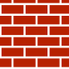









Aviatrix Distributed Cloud Firewall
Centralized Management, Visibility, and Control
Aviatrix
CoPilot
Internet
Aviatrix
Controller
Distributed
Firewalling
IDS / IPS
AZ1
AZ2
AZ1
AZ2
AZ1
AZ2
AZ1
AZ2
NSG
Aviatrix
Secure Egress
NAT Gateways
Aviatrix
Secure Egress
NAT Gateways
Micro-Segmentation
Aviatrix
Secure Egress
NAT Gateways
Threat Prevention
Aviatrix
Secure Egress
NAT Gateways
Distributed Perimeter
Advanced NAT
Cloud
Workloads
Cloud
Workloads
Cloud
Workloads
Cloud
Workloads
Decryption
URL
Filtering
App 1
App 2
App 3
App 4
* IDS/IPS, Decryption, and URL filtering are roadmapped for Spring/Summer 2023
** Micro-segmentation supported in Azure (7.0), Roadmapped for AWS (7.1) and GCP (2H23)

Slide 11
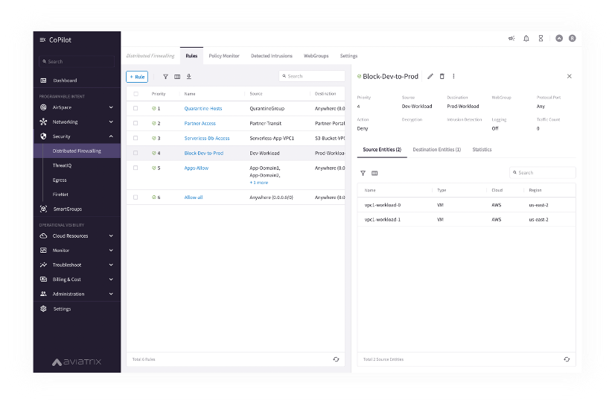



Policy Creation Looked Like One Big Firewall … A Distributed Cloud Firewall…
Where and How Policies Are Enforced Is Abstracted…

Slide 12



SmartGroups: Definition
A firewall rule consists of two important initial elements:
Source
Destination
What is a SmartGroup?
A SmartGroup identifies a group of resources that have similar policy requirements and are associated to the same logical container.
The members of a SmartGroup can be classified using three methods:
CSP Tags
Resource Attributes
CIDR

Slide 13
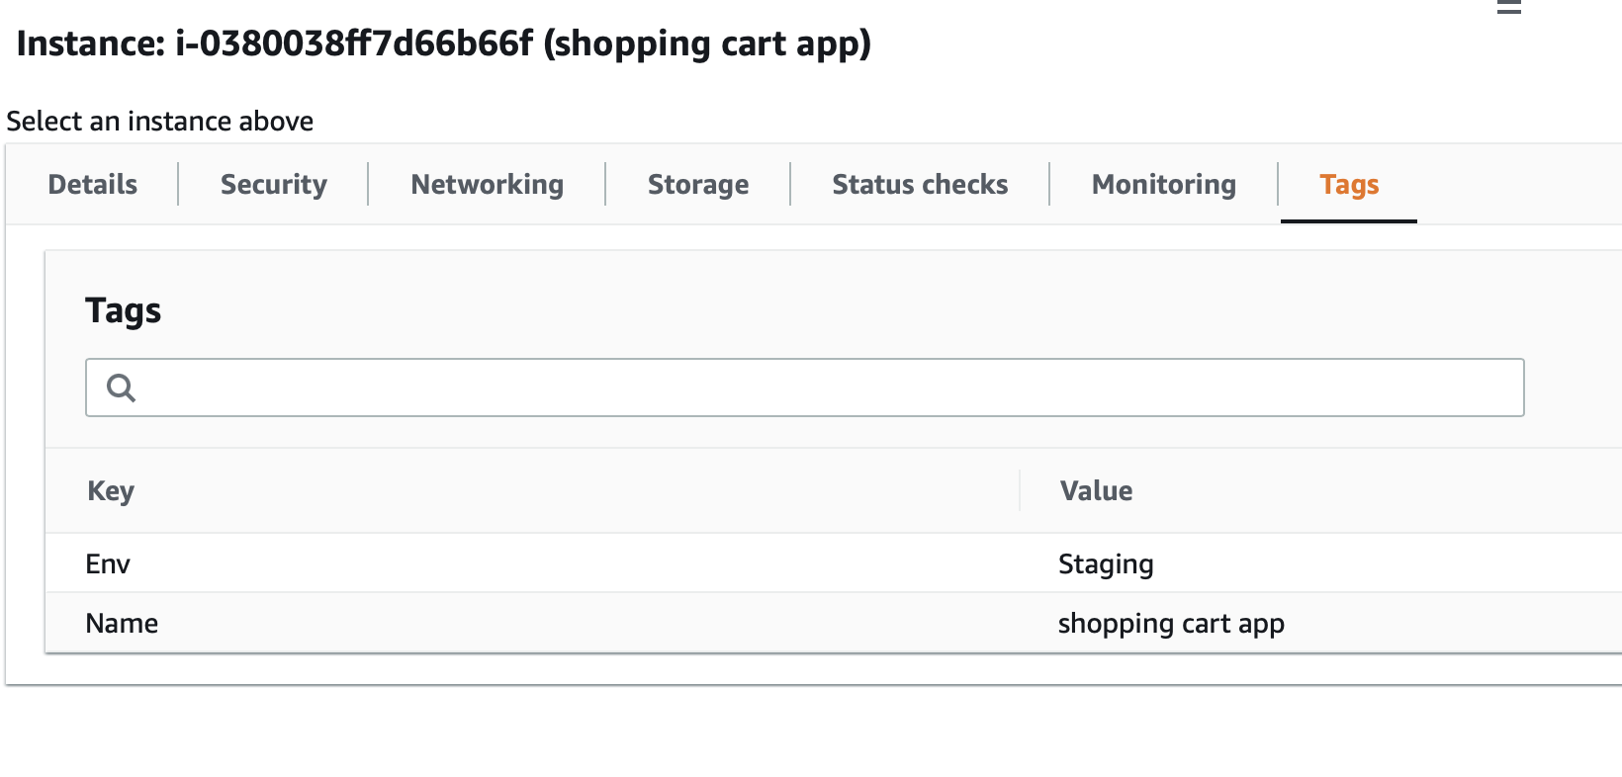
SmartGroups: Classification Methods
CSP Tags (recommended)
Tags are assigned to:
Instance
VPC/VNET
Subnet
Tags are {Key, Value} pairs
Eg: A VM hosting shopping cart application can be tagged with:
{Key: Type, Value: Shopping cart app}
{Key: Env, Value: Staging}
Resource attribute
Region Name, Account Name
IP Prefixes
CIDR

Slide 14
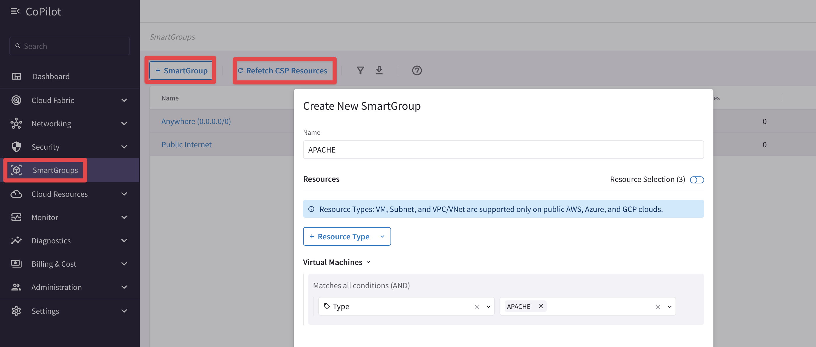

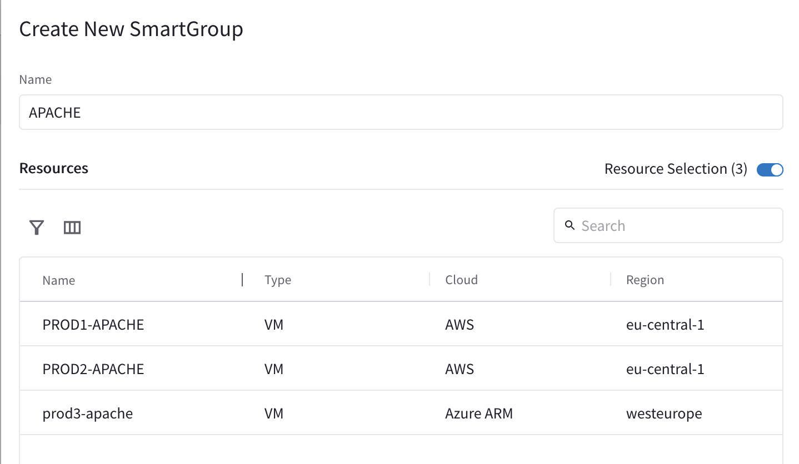
SmartGroups Creation
Controller polls the CSPs to retrieve inventory (about VPCs, instances etc.) every 15 minutes (can be modified)
CoPilot queries Controller every 1 hour (can be modified)
On-demand refresh of tags is available

Slide 15
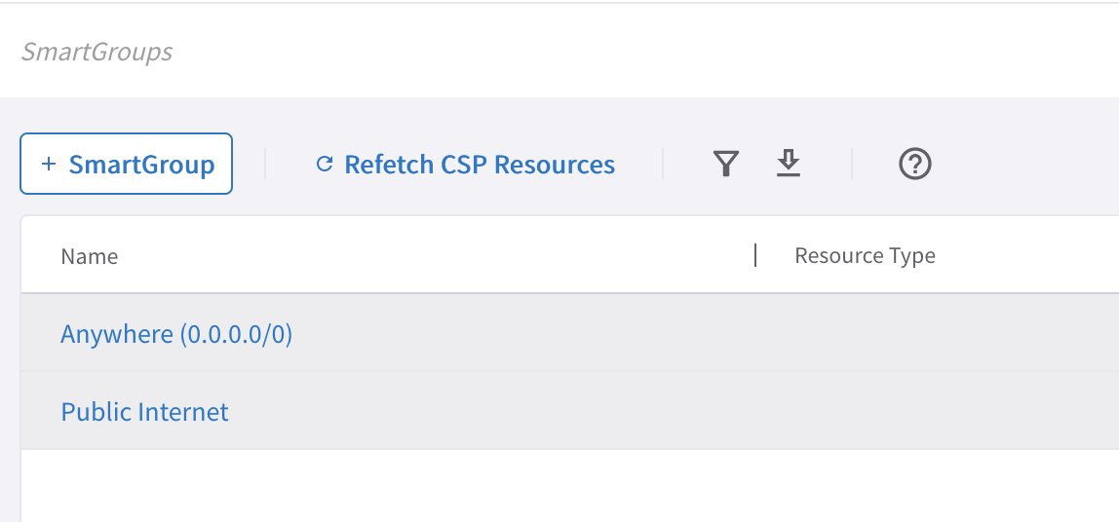
Pre-defined SmartGroups
Anywhere (0.0.0.0/0) → RFC1918 routes + Default Route (IGW)
Public Internet → Default Route (IGW)

Slide 16
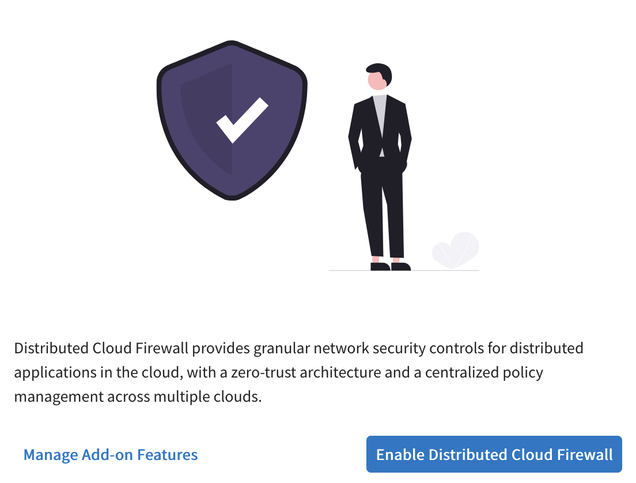
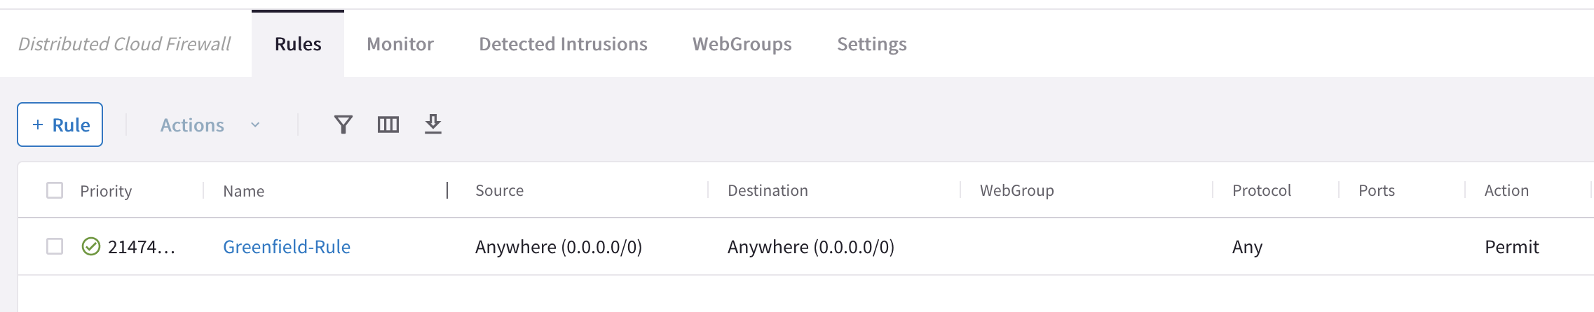
Enabling Distributed Cloud Firewall
Enabling the Distributed Cloud Firewall without configured rules will deny all previously permitted traffic due to its implicit Deny All rule.
To maintain consistency, a Greenfield Rule will be created to allow traffic that maintains the current state, facilitating the creation of custom rules for specific security needs.

Slide 17
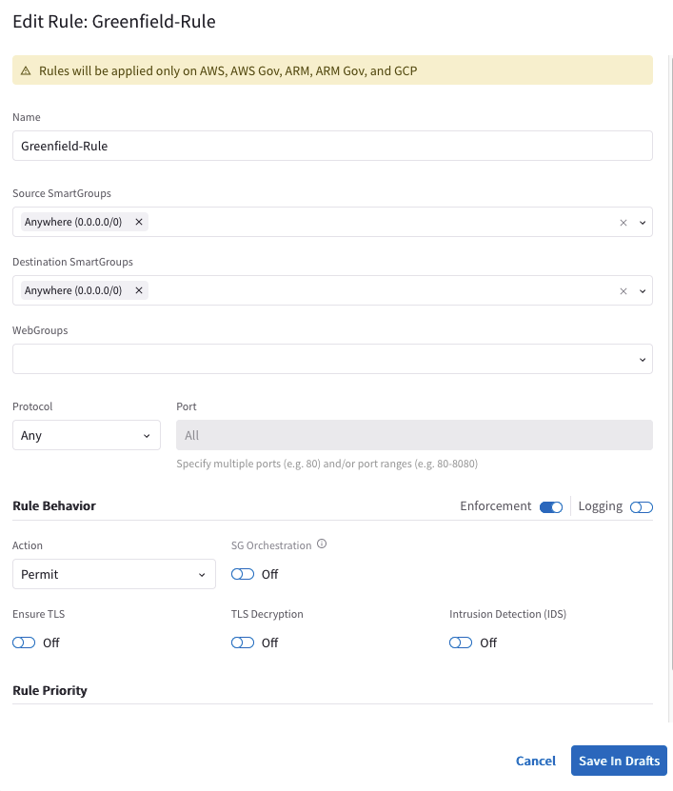
The Greenfield-Rule Structure
Source SmartGroups: Anywhere(0.0.0.0/0)
Destination SmartGroups: Anywhere(0.0.0.0/0)
Protocol: Any
Action: Permit
Can be edited and deleted
It can be moved when new rules are created like any other rules
If it is the only rule present in the rules base, it is allocated above the implicit deny-all rule

Slide 18




TLS Decryption: Basic TLS Connection
ISRG-Root-CA
-- aviatrix.com
TCP 3-Way Handshake
Server
Client
Aviatrix.com
CA Trust Bundle
Server Cert
Client Hello: TLS Version, Cipher list, SNI etc
Godaddy-Root-CA
ISRG-Root-CA
Server Hello: Selected TLS Version, Selected Cipher, Server Cert
TLS-1
Http Request: URI
Decrypt with TLS-1
Decrypt with TLS-1

Slide 19
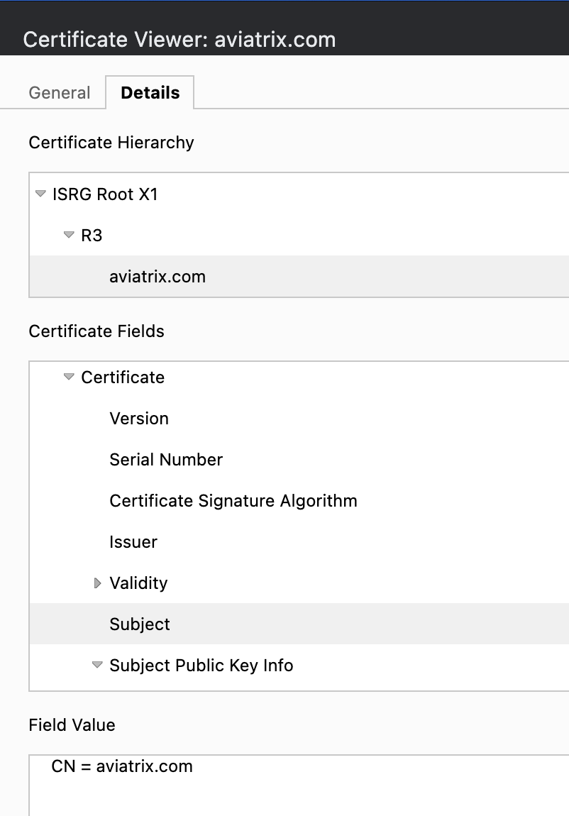
TLS Decryption: PKI/ KMS and Trust Bundle
Certificate Hierarchy
Root
Intermediate
Server Cert (Leaf Cert)
Certificate Fields
Issuer
Validity
Subject
Trusted Root CA Bundle
Used by the Client and/or Proxy Gateway to Identify/ Trust the Original Server Cert
Decryption CA Cert
Used by the Decryption/Proxy gateway to generate a new Proxy-Server Cert and Sign it with the Decryption CA Cert

Slide 20

TLS Decryption: Basic TLS Decryption
Signed by Public CA
TCP 3-Way Handshake
Spoke
Proxy Server
Server
Client
Proxy Client
Server
ISRG-Root-CA
-- aviatrix.com
Pvt-Root-CA
- Pvt-Decrypt-CA-1
Proxy Trust Bundle
Client Trust Bundle
Godaddy-Root-CA
ISRG-Root-CA
Aviatrix.com
Godaddy-Root-CA
ISRG-Root-CA
Pvt-Root-CA
Client Hello: TLS Version, Cipher list, SNI (aviatrix.com) etc
Server Cert
Proxy Client Hello:
TLS Version, Cipher list, SNI (aviatrix.com) etc
On the fly Signed by Pvt Decrypt CA
Pvt-Root-CA
- pvt-Decrypt-CA-1
- aviatrix.com (Proxy)
Server Hello: Selected TLS Version, Selected Cipher, Server Cert (aviatrix.com)
Pvt-Root-CA
- Pvt-Decrypt-CA-1
Proxy Server Hello : Selected TLS Version, Selected Cipher,
Proxy Server Cert (aviatrix.com)
TLS-1
TLS-2
Encrypt with TLS-1
Decrypt with TLS-1
Encrypt with TLS-2
Decrypt with TLS-2
Http Request: URI
Http Request: URI

Slide 21
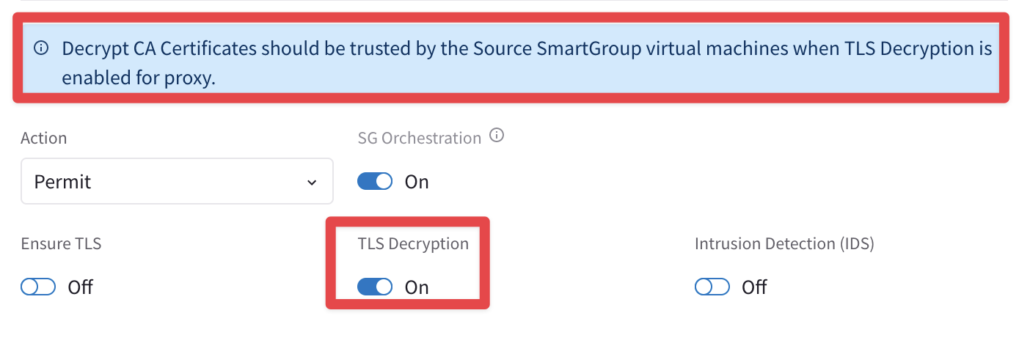
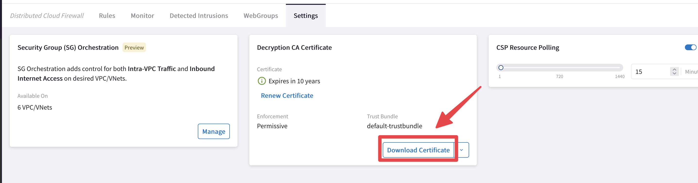
TLS Decryption: Decryption CA Cert
Download the Decryption CA Bundle.
Distribute the bundle across all the workloads.
Decrypt CA Certificates should be trusted by the Source SmartGroup virtual machines when TLS Decryption is enabled for proxy.

Slide 22





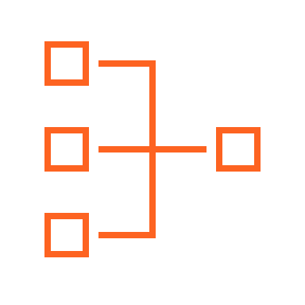

Distributed Cloud Firewall Rule Types: Intra-rule vs. Inter-rule
Smart Groups
VPC
VPC
VNet
VNet
Apache
Nginx
VPC
VPC
VNet
VNet
A rule between SGs can be defined for achieving the INTER-SMARTGROUP communication
Region 1
Region 2
Region 1
Region 2
INTRA-RULE: is defined within a Smart Group, for dictating what kind of traffic is allowed/prohibited among all the instances that belong to that Smart Group
INTER-RULE: is defined among Smart Groups, for dictating what kind of traffic is allowed/prohibited among two or more Smart Groups.

Slide 23
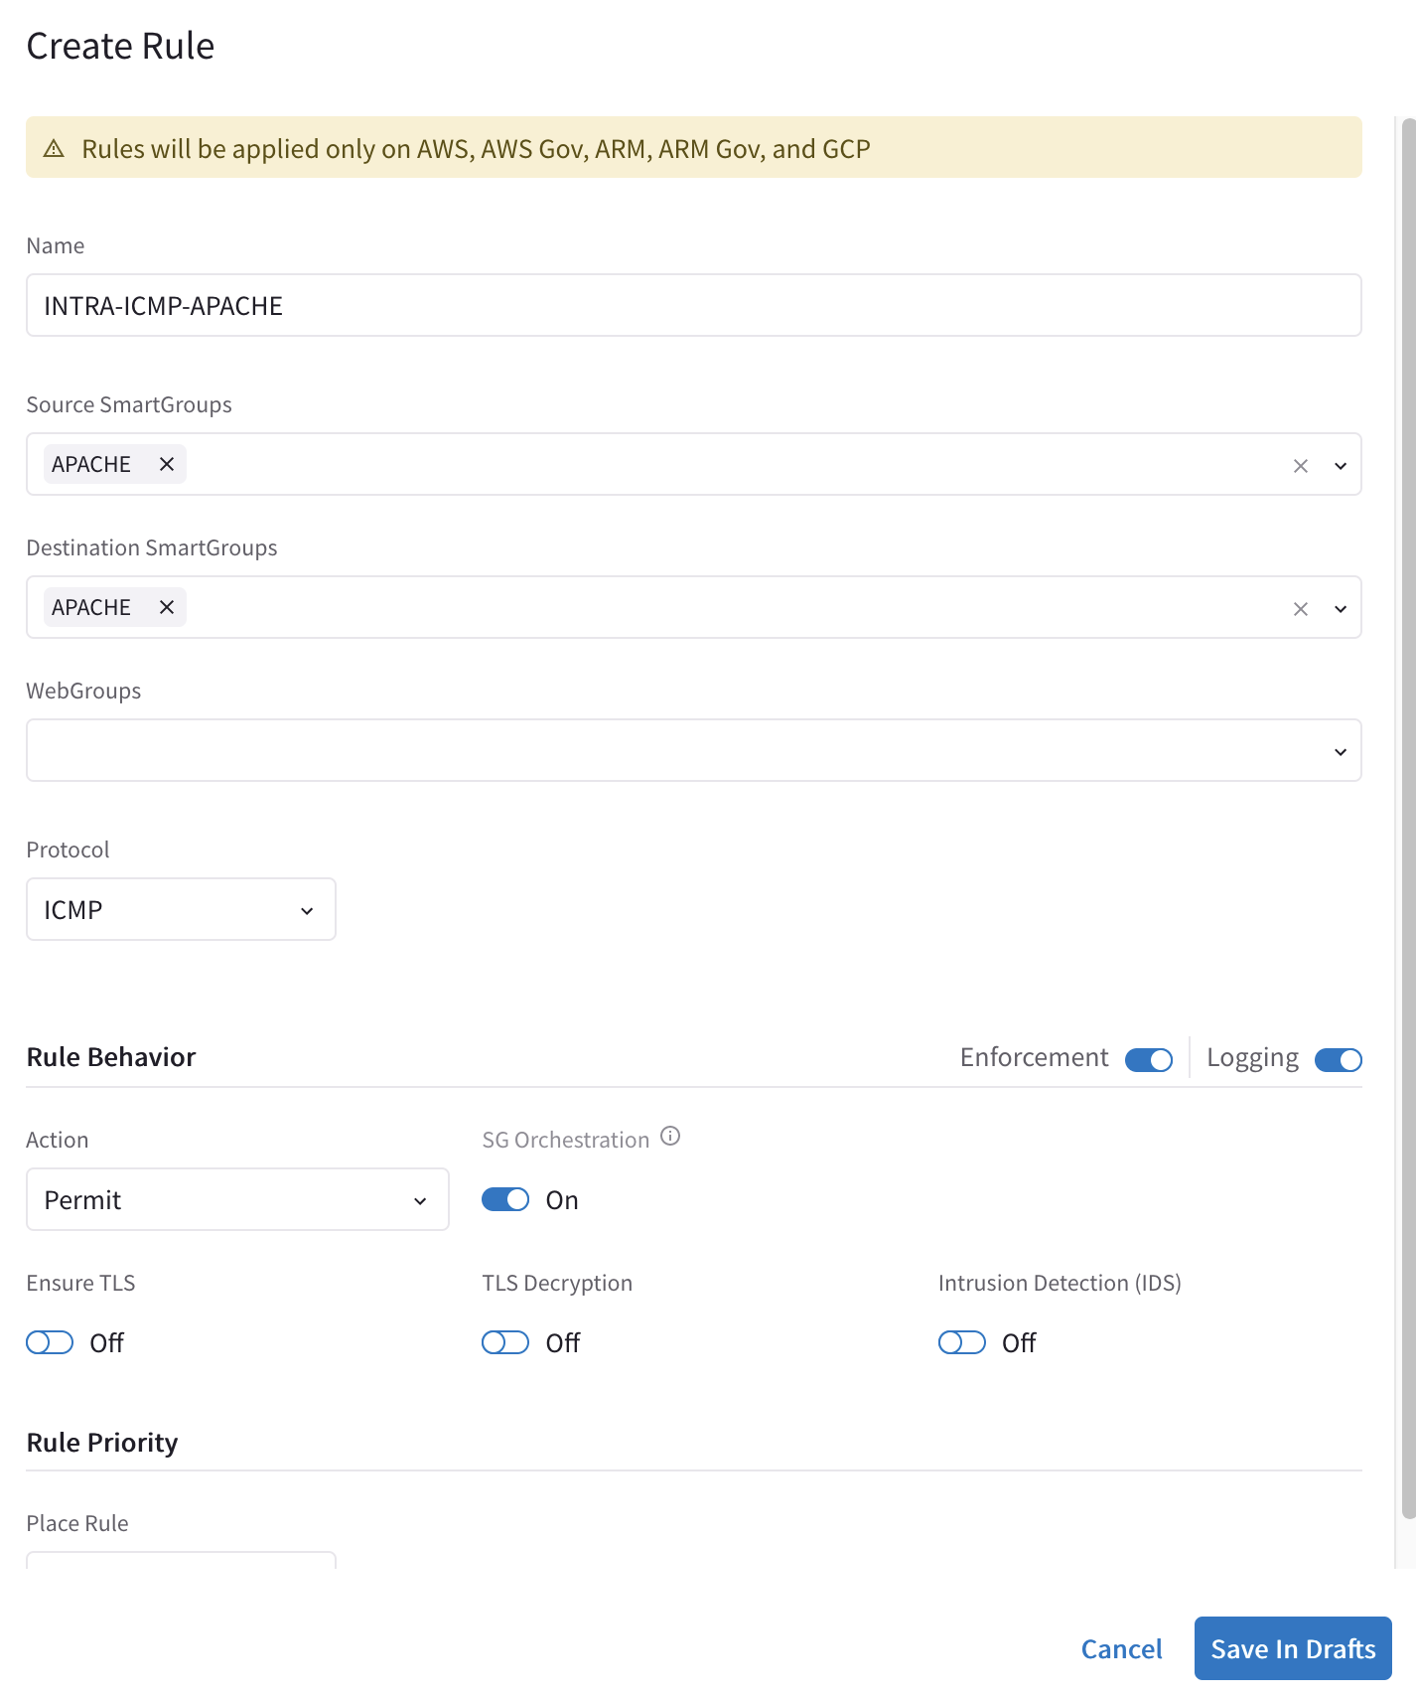
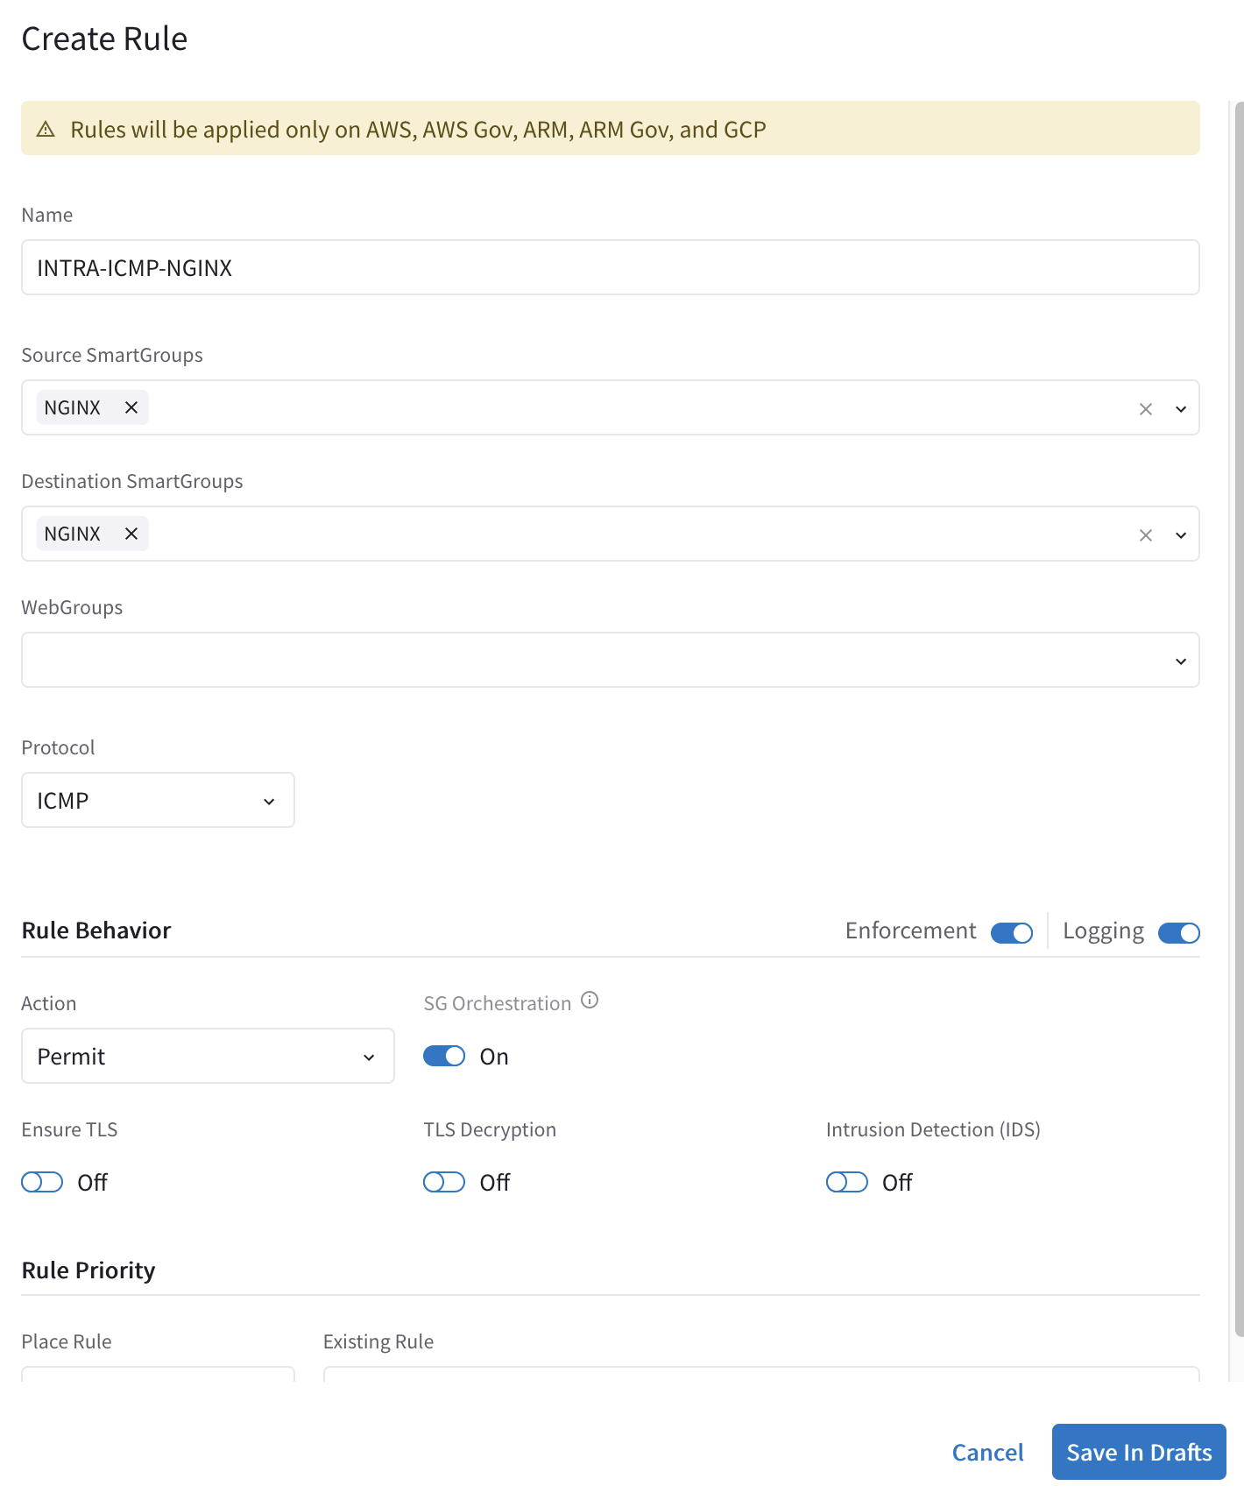
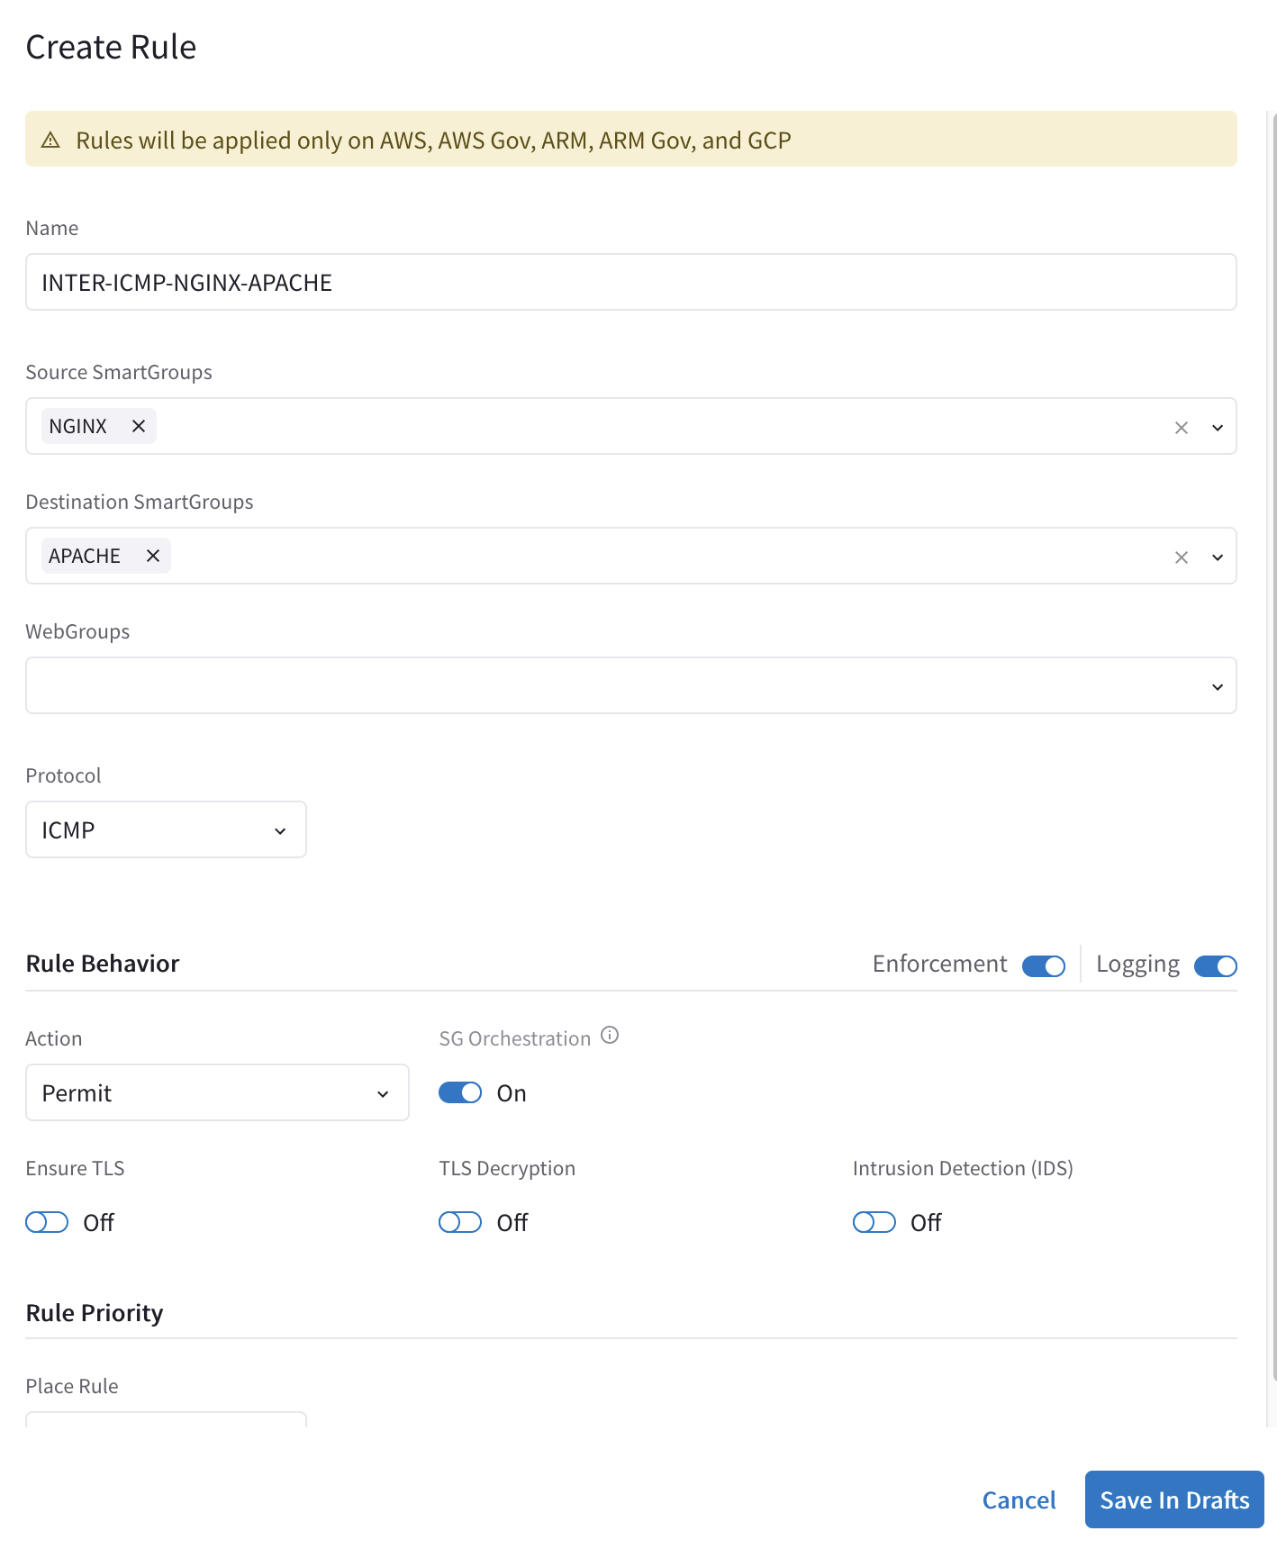

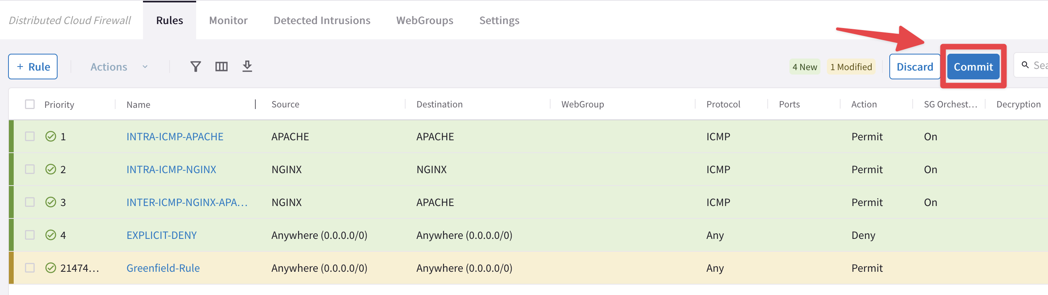
Micro-Segmention: SmartGroups, Intra-Rules and Inter-Rules
intra
SmartGroup
Nginx
intra
SmartGroup
Nginx
inter
SmartGroup
Apache
SmartGroup
Apache
VPC
VPC
VNet
Region 1
Region 2
Micro-Segmentation: Combination of SmartGroups and DCF Rules
Rule changes are saved in Draft state.
When you apply a rule to a SmartGroup, please keep in mind that there is an Invisible Hidden Deny at the very bottom.
To save the changes click on “Commit”
Discard will trash the changes
Rule is stateful, this means that the return traffic is allowed automatically
A rule between SGs can defined for achieving the INTER-SMARTGROUP communication

Slide 24
Network Segmentation & Distributed Cloud Firewall Rule together
Network Domains
Smart Groups
NO connection policy is applied
Network Domains
Smart Groups
LOB1
LOB2
Apache
Nginx
LOB1
LOB2
Apache
Nginx
VPC
VPC
VNet
VNet
VPC
VPC
VNet
VNet
A rule between SGs can be defined for achieving the INTER-SMARTGROUP communication
Region 1
Region 2
Region 1
Region 2
Scenario #1:
Intra-rule applied within a SmartGroup defined within the same Network Domain: NO impact to the rule
Inter-rule applied between SmartGroups defined within the same Network Domains: NO impact to the rule
Scenario #2:
Intra-rule applied within a SmartGroup defined across two Network Domains: Intra-rule is impacted.
Inter-rule is applied between SmartGroups defined across two different Network Domains: Inter-rule is impacted
Caveat:
Network Segmentation and Distributed Firewalling are NOT mutually exclusive!
Network Segmentation takes precedence over the extent of a SmartGroup

Slide 25
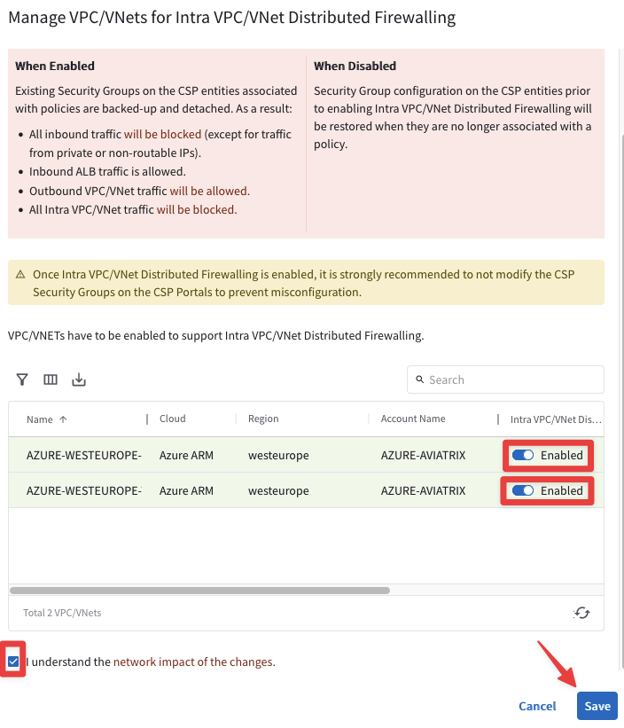
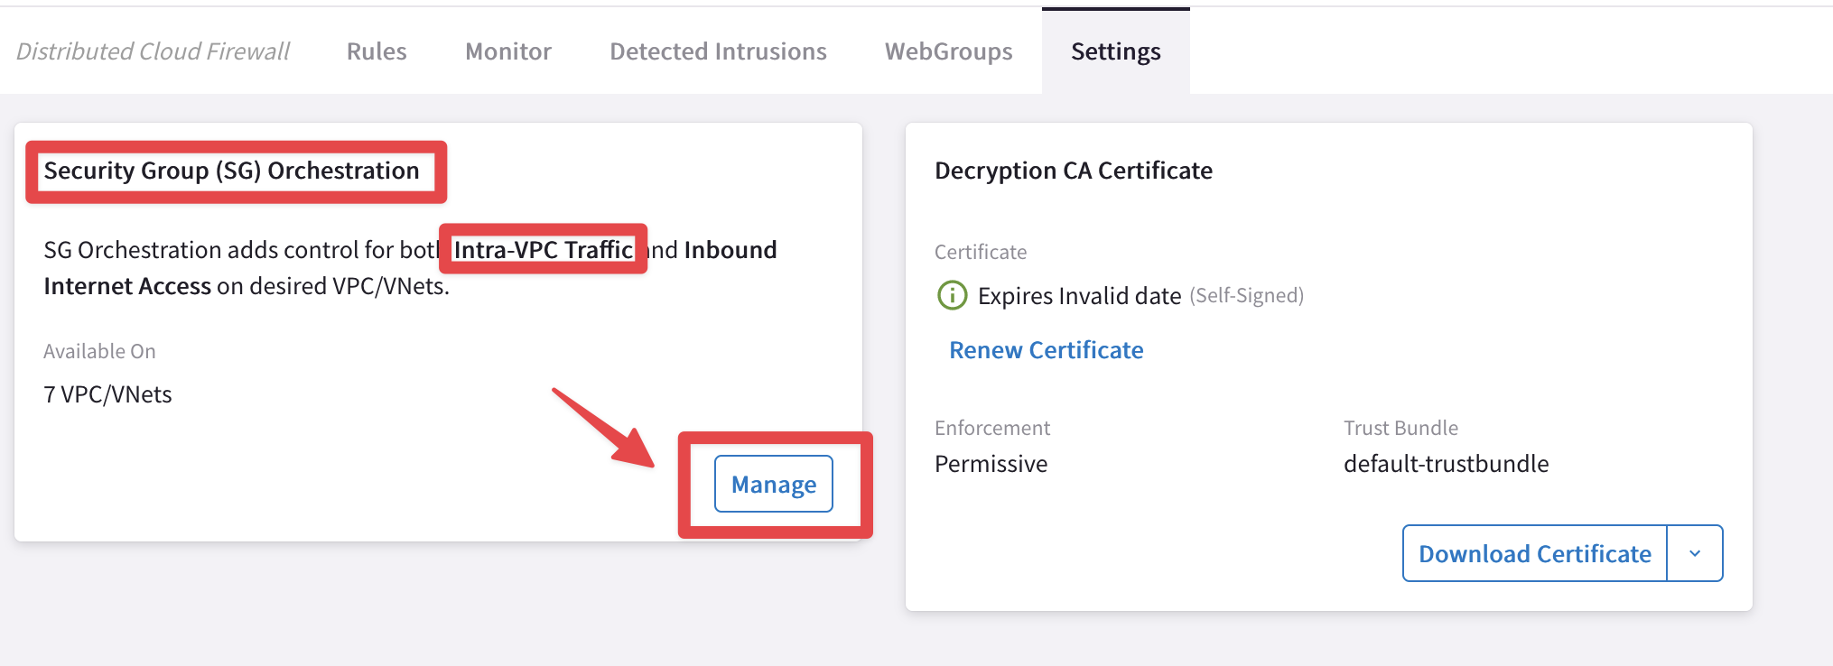
Security Group (SG) Orchestration: Intra VPC/VNET Traffic Control
Enable the feature on the relevant VPC/VNet
VNet
SmartGroup #1
SmartGroup #2
If you enable the Security Group (SG) Orchestration (aka Intra-VPC Traffic Control), the SmartGroups defined within the same VPC/VNet will not be able to communicate with each other, unless an inter rule is applied between them.
This is pure L4 separation, leveraging the Native Cloud Constructs (such as SG, NSG and ASG). This is not L7 inspection.
CAVEAT: Available in AWS/Azure
Transit
Spoke

Slide 26
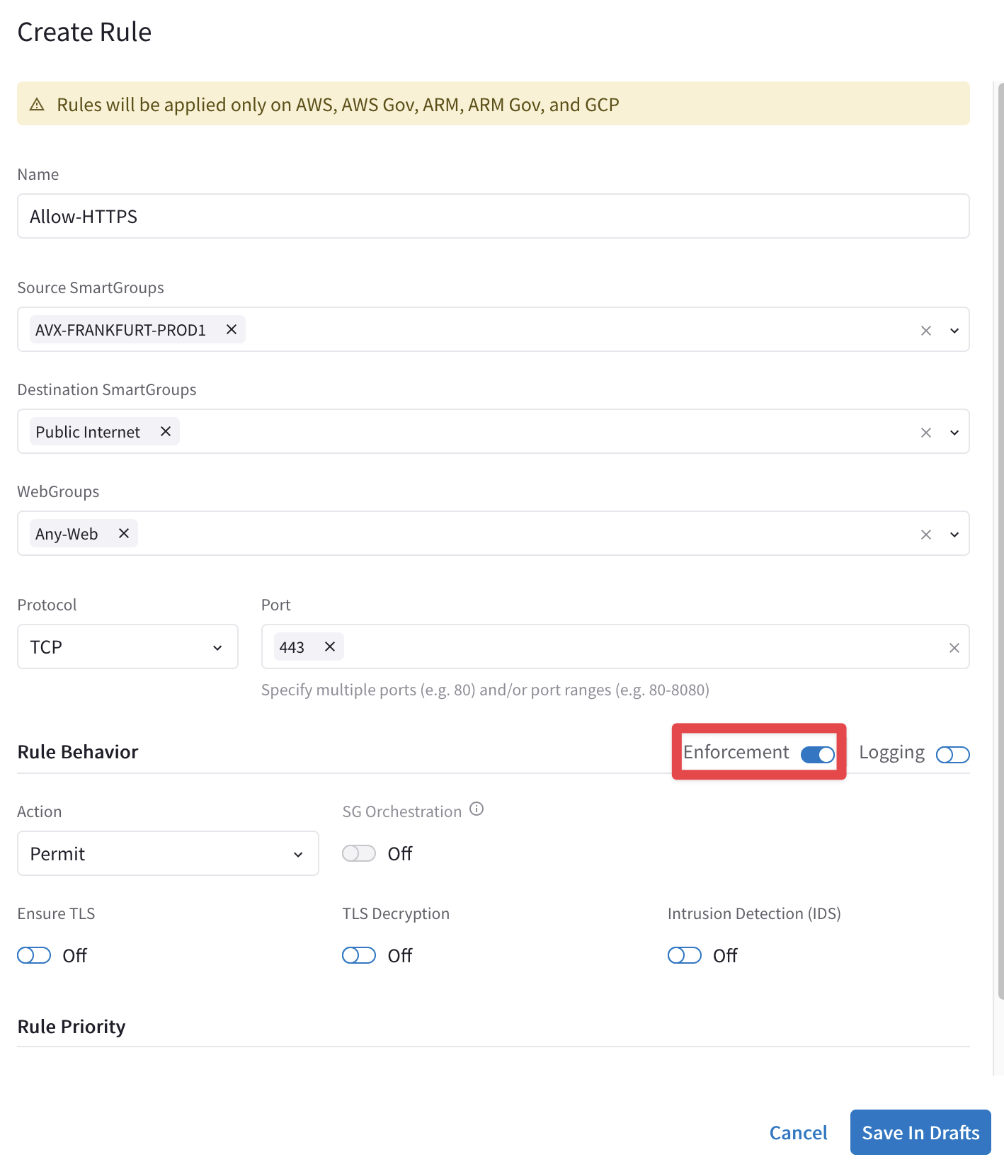
Rule Enforcement
Enforcement ON
Policy is enforced in the Data Plane
Enforcement OFF
Policy is NOT enforced in the Data Plane
The option provides a Watch/Test mode
Common use case is with deny rule
Watch what traffic hits the deny rule before enforcing the rule in the Data Plane.

Slide 27
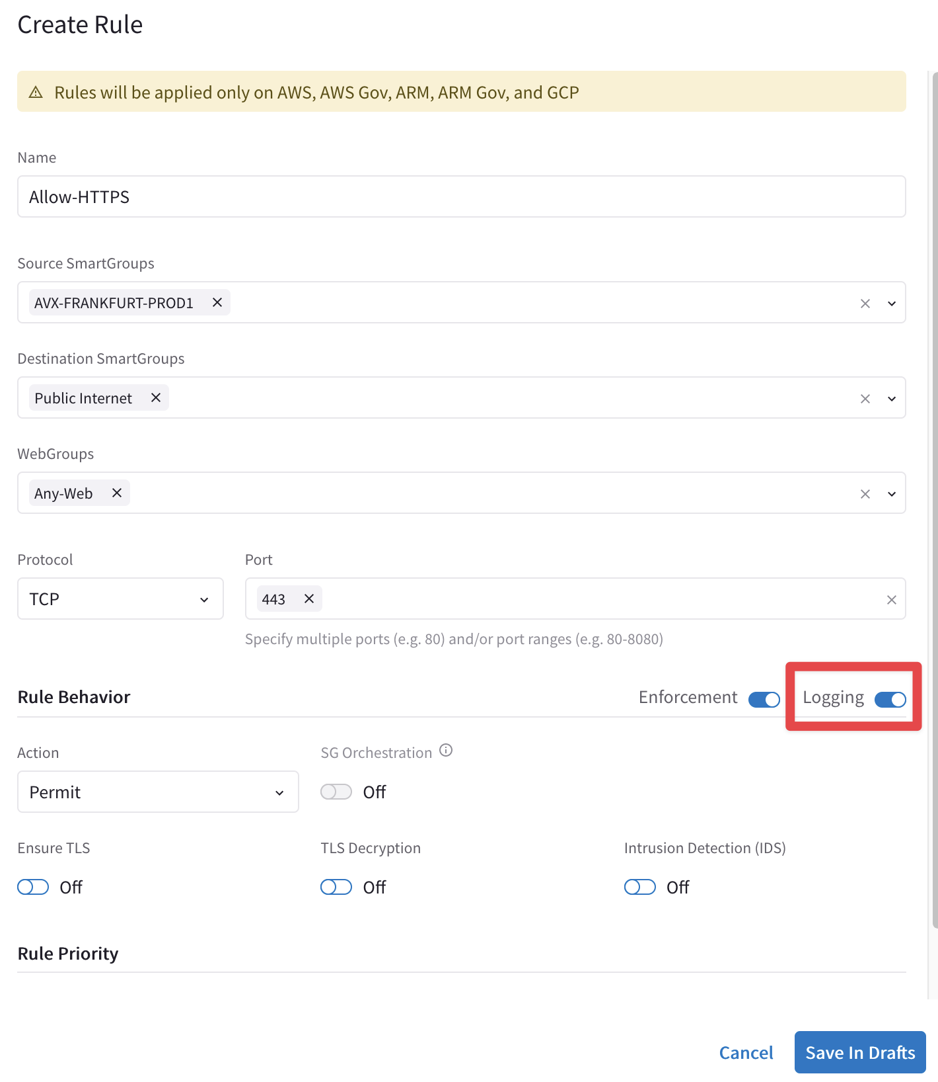
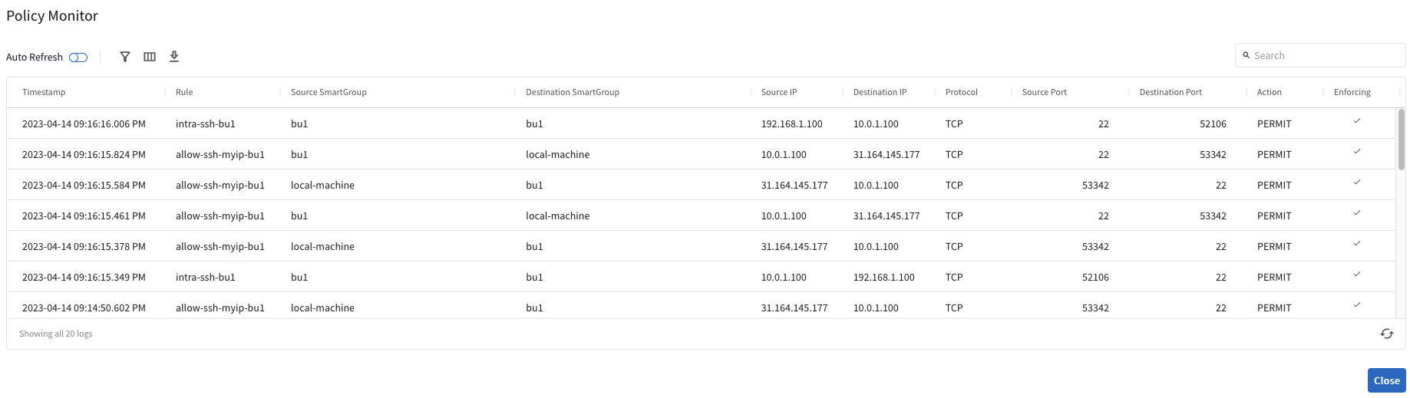
Rule Logging
Logging can be turned ON/OFF per rule
Configure Syslog to view the logs

Slide 28
DFW Engines At-a-Glance
eBPF (extended Berkeley Packet Filter) Engine (L4) → Stateful Firewall Rule (forwarding path)
WebProxy ATS (Apache Traffic Server) Engine (L7) → it is triggered whether WebGroups or TLS Decryption are required
Suricata Engine (DPI) → Signature of the payload (only in IDS mode at the moment)
Spoke Gateway
Suricata
IDS
IDS = Yes
Mirror Packet
IDS = Yes
Mirror Packet
WebGroup Miss – Continue Evaluating L4/L7
eBPF Engine
( L4 )
Match Src/Dst
Contains WebGroups or Decrypt
ATS Engine
( FQDN/URL + TLS Decrypt )
IPTables, Routing, NAT ->
Stateful FW
Legacy FQDN
Netflow (L4/L7)
WebGroups Match - Allow
Packet In
Deny
L4 Allow
WebGroups Match - Deny
Drop
Drop

Slide 29
Supported Capabilities
Capability | 6.7 | 6.8 | 6.9 | 7.0 | 7.1
Distributed Cloud Firewall is supported in the following cloud providers: | AWS, Azure | AWS, AWS GovCloud, Azure, Azure Government, and GCP | AWS, AWS GovCloud, Azure, Azure Government, and GCP | AWS, AWS GovCloud, Azure, Azure Government, and GCP | AWS, AWS GovCloud, Azure, Azure Government, and GCP
You can configure up to 500 SmartGroups | x | x | x | x | x
You can have up to 3000 CIDRs per SmartGroup | x | x | x | x | x
Number of rules per policy | 64 | 2000 | 2000 | 2000 | 2000
Number of port ranges | 1 | 64 | 64 | 64 | 64
Overlapping IPs are supported |  |  |  | x | x
Security Group Orchestration is supported |  |  |  | x (Azure) | x (AWS and Azure)

Slide 30
Next: Lab 10 – Distributed Cloud Firewall

